Slide 1
”DIKSHA” Sundaram Fin.Tech 2025
Journey Presentation –week 7
Anil Rasa
Date : 29-MAR-2025

Slide 2

Topics Covered in Seventh Week !

Slide 3
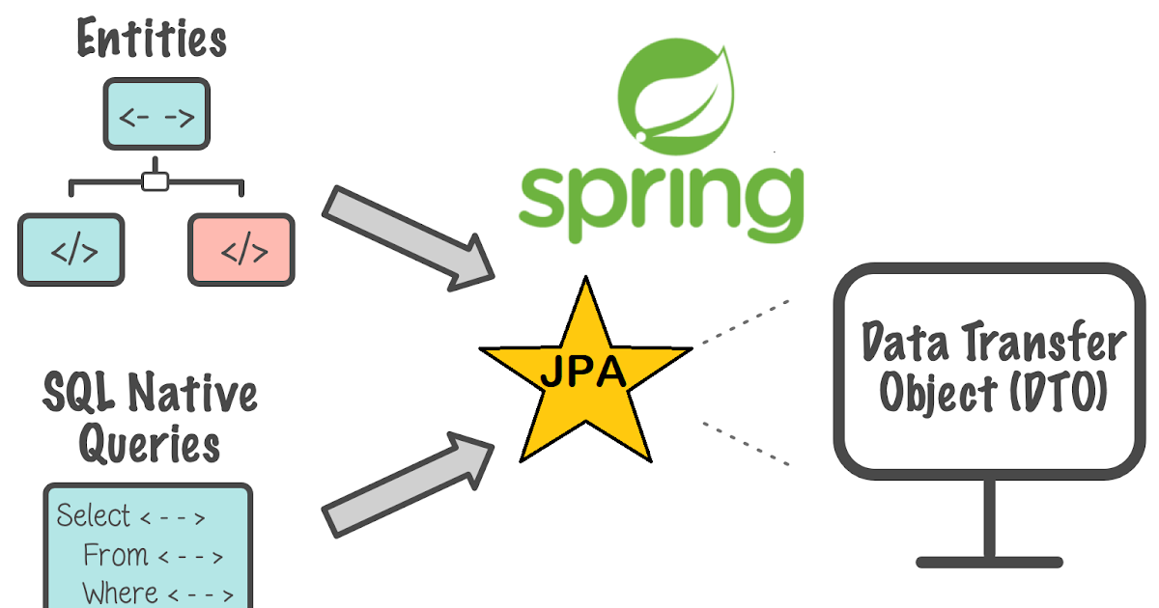
Learning 1 | My takeaways
→Relationship
→Annotations
→Spring JPA

Slide 4
Spring JPA: Spring Data JPA, part of the larger Spring Data family, makes it easy to easily implement JPA-based repositories. It makes it easier to build Spring-powered applications that use data access technologies.
Features:
→Getting Started: Sophisticated support to build repositories based on Spring and JPA
→Various Query Methods: Pagination support, dynamic query execution, ability to integrate custom data access code
→Auditing: Transparent auditing of domain class
→Configuration: Modern configuration using annotations as well as legacy support for XML-based systems.
Relationships:
In Java Persistence API (JPA), relationships are used to represent associations between entities in a relational database.
→One-to-One Relationship
→ One-to-Many Relationship
→Many-to-One Relationship
Many-to-Many Relationship
Annotations:
→@Entity annotation defines that a class can be mapped to a table
→@Id annotation is used to indicate the primary key of an entity, which uniquely identifies each instance of the entity in the database
→@Column this annotation is not used, JPA uses the name of the field by default
→@Generatedvalue annotation, the name itself suggests that it will generate something.
Q

Slide 5
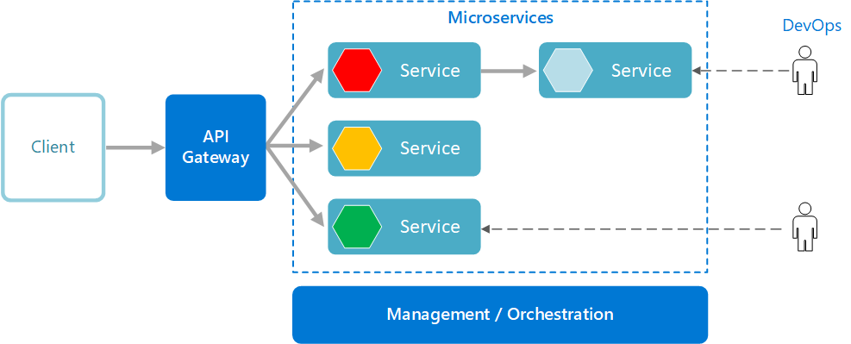
Learning 2| My Takeaways
→ Microservices
→Monolithic Application
→ Microservice Architecture
→One Microservice Interact with another

Slide 6
Microservices: Microservices are a software development style that uses small, independent services to work together to perform a larger function.
How Microservices work:
→Distributed architecture: Microservices are loosely coupled, so the failure of one component doesn't affect the entire application.
→Independent services: Each service has a distinct purpose and can function independently of the others.
→API contracts:Services communicate with each other using well-defined API contracts
Monolithic :a monolithic application is a software application designed as a single, unified unit, meaning all its components are tightly coupled and deployed together.
→ A monolithic architecture is a traditional model of a software program, which is built as a unified unit that is self-contained and independent from other applications
MicroService Architecture:
Microservices architecture is a method of developing applications as a collection of small, independently deployable services, each with its own business logic and database, allowing for better scalability, independent deployments, and technology flexibility
How Microservice Communicate With Another:
Microservices communicate with each other using inter-service communication protocols like HTTP, gRPC, or message brokers, employing both synchronous and asynchronous messaging patterns

Slide 7
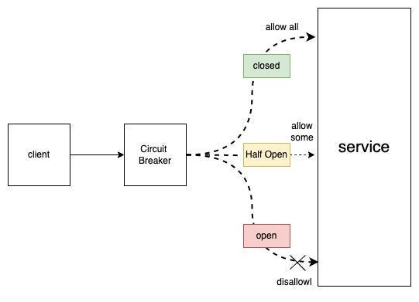
Learning 3| My takeaways
→Spring Cloud Gateway
→Spring Validation
→Circuit Breaker

Slide 8
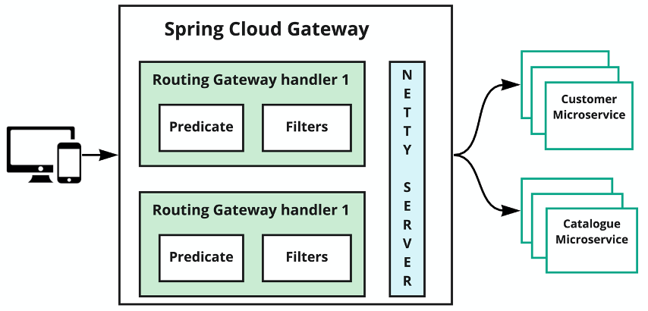
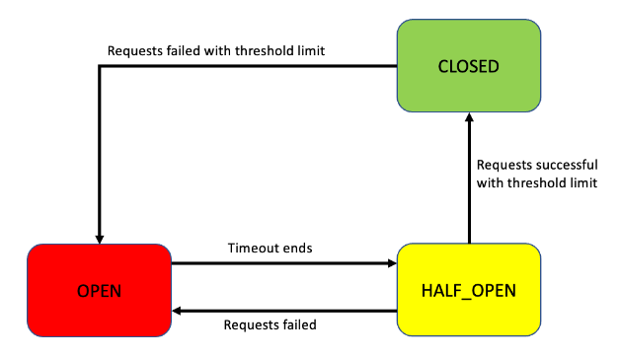
Spring Cloud Gateway:
Spring Cloud Gateway is a project that provides libraries for
building an API gateway on top of Spring WebFlux or Spring
WebMVC, offering a simple way to route requests to microservices
and handle cross-cutting concerns like security, monitoring, and
Resiliency.
Features:
1)Built on Spring Framework 5, Project Reactor and Spring Boot 2.0
2)Able to match routes on any request attribute.
3)Predicates and filters are specific to routes.
4)Hystrix Circuit Breaker integration.
Spring Validation:
Hibernate Validator provides a powerful and flexible way to validate data in Spring Boot applications. Validating user input is essential for building secure and reliable applications. Spring Boot makes this easy with Hibernate Validator, the reference implementation of JSR 380 (Bean Validation API). It allows developers to use rules on user inputs using simple annotations like @NotNull, @Size, and @Email.
The circuit breaker pattern is a design pattern used in
software development to handle faults and prevent
cascading failures in distributed systems. It works like
an electrical circuit breaker, protecting the system from
being overwhelmed when a service or resource becomes
unavailable or faulty.

Slide 9
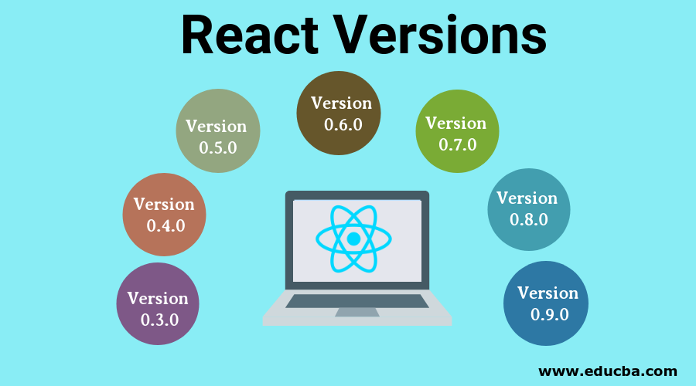
Learning 4 | takeaways
→What is React
→Introduction to React
→React Setup
→ Understanding JSX

Slide 10
What is React:
React.js (or simply React) is a popular JavaScript library for building user interfaces (UIs) or UI components for web applications. It was developed and is maintained by Facebook (now Meta) and is widely used by developers to create fast, dynamic, and interactive web applications.
Introduction to React:
→It is developed by Facebook,The Developer of the react is JordanWalke.
→React uses a virtual DOM to optimize rendering performance. Instead of directly manipulating the browser's DOM, React creates a virtual DOM in memory, where it performs all necessary updates before applying changes to the actual DOM.
DOM: Document Object Model, is a programming interface for web documents that represents them as a tree-like structure, allowing scripting languages like JavaScript to dynamically access, modify, and interact with the content, structure, and style of a webpage.
JSX: JavaScript XML, is a syntax extension for JavaScript that allows developers to write HTML-like code within their JavaScript code. It is commonly used in React to define the structure and content of user interface components. JSX makes it easier to visualize and work with UI elements, as it closely resembles the HTML structure. However, it's not valid JavaScript and needs to be transpiled into regular JavaScript code before it can be executed by a browser.

Slide 11
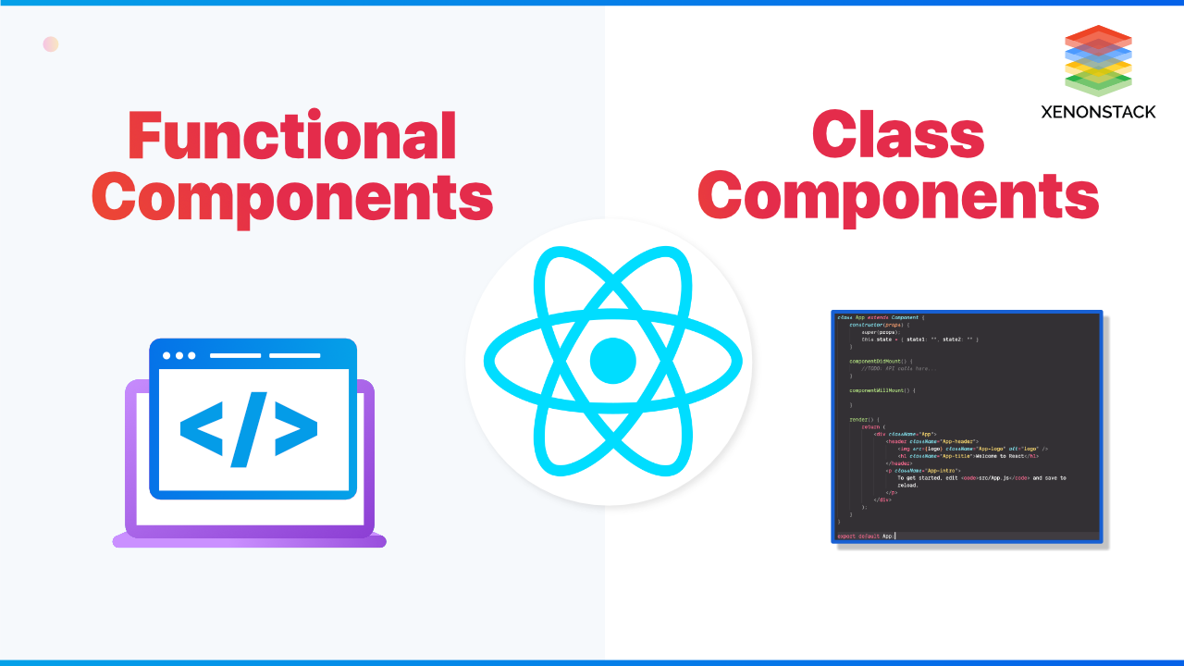
Learning 5 | takeaways
→Build Tools
→React Folder Structure
→Class Component
→Funtional Component

Slide 12
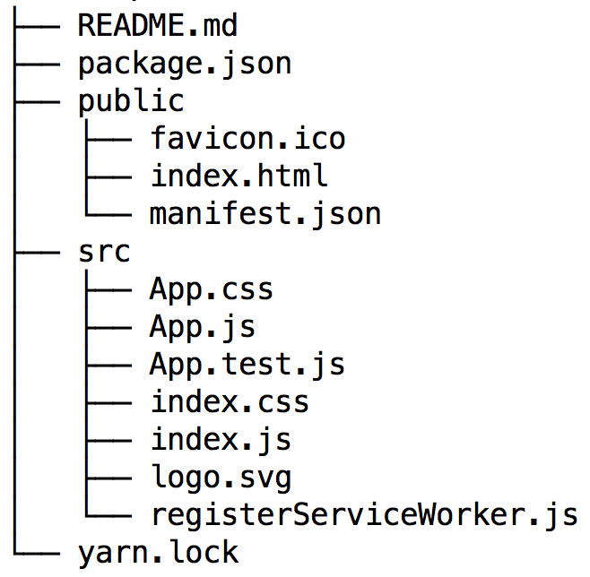
Build Tools:
Build tools in web development are used to automate and simplify tasks
There are two types of build tools:
1)CRA
2)Vite
React Folder Structure:

Slide 13
Class Component:
EX:
Class Class_name{
render(){
return <h1>hi hello every one</h1>
}
}
Funtional Component:
EX:
Function Function_name(){
return
{
<h1>hi hello every one</h1>
}
}

Slide 14
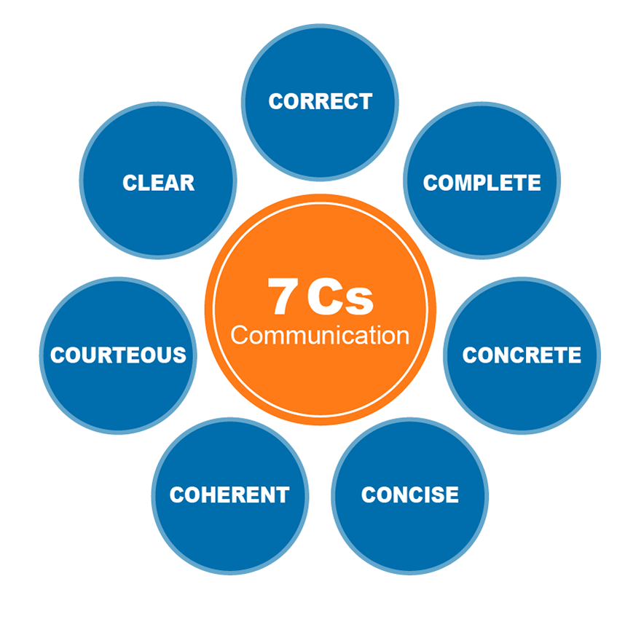
Learning 6 | takeaways
→7Cs Communication
→Non-verbal Communication
→Barriers of communication
→Vocal tone

Slide 15
7Cs Communication:
Clarity: Be clear about the message you want to convey. Use simple, precise language to avoid misunderstandings.
Conciseness: Keep your message brief and to the point. Avoid unnecessary details or filler words.
Concreteness: Be specific and provide solid facts, details, or examples to support your message.
Correctness: Ensure the message is grammatically correct, free from errors, and appropriate in tone and context.
Consideration: Be empathetic to the audience’s perspective, needs, and feelings.
Courtesy:Maintain a respectful and polite tone, showing regard for others in your communication.
Connection: Establish a strong rapport with your audience to make the message more relatable and engaging.
Non-verbal communication : It refers to the transmission of messages or information without the use of words. It includes body language, facial expressions, gestures, posture, eye contact, tone of voice, and even physical space. It often complements verbal communication and can sometimes convey more than words themselves.
Barriers to communication:
Barriers to communication are obstacles that prevent people from understanding a message, or understanding it the same way. They can be physical, emotional, cultural, cognitive, or systematic.
Vocal Tone :It refers to the quality, pitch, volume, and modulation of your voice when speaking. It plays a crucial role in communication because it can convey emotions, attitudes, and intentions beyond the words you say. Even if the words are clear, the tone can completely change the message’s meaning.
→It Include:
1)Pitch 2)Volume 3)Rate (Speed of Speaking) 4)Inflection 4)Emphasis 5)Quality 6)Pauses

Slide 16
Thank You

